Slide 1
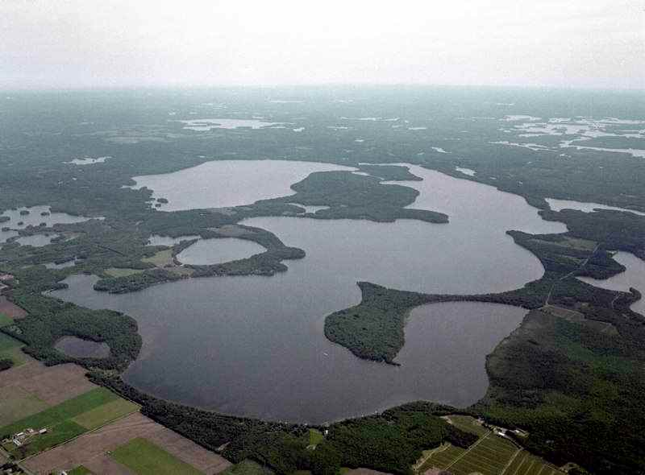
Threats, Impacts, and Citizen Action on Lac Courte Oreilles Jim Coors, COLA Communications Director

Slide 2
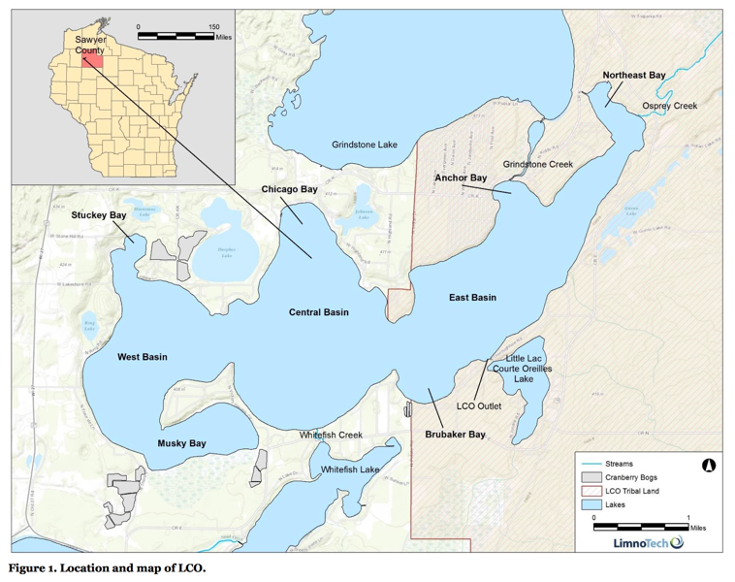
Notes:
5,039 acre - 8th largest natural drainage lake in Wisconsin
Max. depth—95 ft , Avg. depth -- 35 ft
LCO Band of Lake Superior Chippewa:
Tribal enrollment is nearly 6,000 (60% live on or near LCO)
Tribe occupies ~ 69,000 ac
Tribal Conservation Dept.
Essential partner in the preservation of LCO with major input on water quality testing since mid-1990s

Slide 3
LCO Band of Lake Superior Chippewa
Tribe occupies ~ 69,000 ac
Most of NW Wisconsin is part of Ceded Territory
Tribal enrollment is nearly 6,000 (60% live on or near LCO)
Tribal Conservation Dept.
Essential partner in the preservation of LCO with major input on water quality testing since mid-1990s

Slide 4
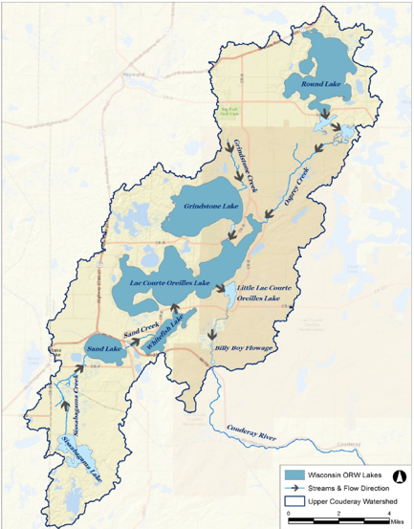
Upper Couderay River Watershed
68,990 ac
Forested (61%)
Agricultural (12%)
Developed (9%)
Grassland/Pasture/Shrubland (5%)
Open Water (7%)
Wetlands (6%)

Slide 5
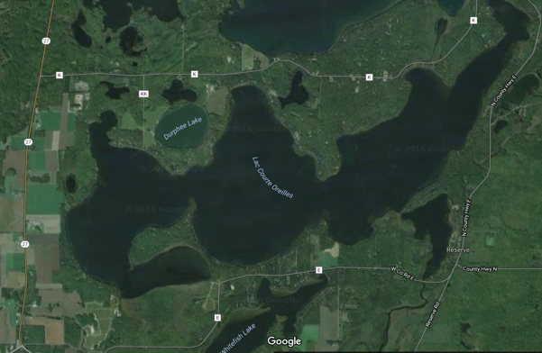
Five cranberry bogs totaling 169 acres are located within the direct drainage areas of Musky Bay, Stuckey Bay, West Basin, and East Basin.
Additional cranberry bogs totaling 111 acres are located in the direct drainage to Sissabagama Lake

Slide 6
Lac Courte Oreilles
- a very sensitive lake -
Classified as an oligotrophic, Outstanding Resource Water (ORW)
Of Wisconsin’s 15,000 lakes and impoundments, 103 are designated as ORW—fewer than 1%
The ORW designation is intended to meet federal Clean Water Act obligations requiring Wisconsin to adopt an “antidegradation” policy that is designed to prevent any lowering of water quality – especially in those waters having significant ecological or cultural value.
Protected by Wisconsin’s antidegradation rule (WAC NR 207.03(3))

Slide 7
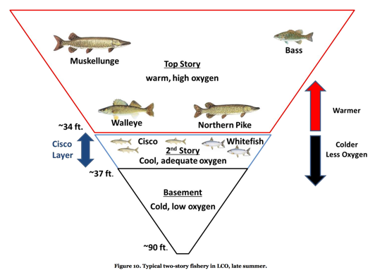
Lac Courte Oreilles
- a very sensitive lake -
LCO is a stratified, two-story cold-water fishery
One of about 5 such lakes in Wisconsin with self-sustaining populations of both whitefish and cisco
A TP criterion of 15 μg/L is applied to these lakes in Wisconsin by administrative code

Slide 8
Real Estate, Taxes, Expenditures (2009)
Lac Courte Oreilles
$331 million tabulated Fair Market Value
~ 85% seasonal, 15% year-round residents
$2.9 million local taxes
Associated expenditures from residents and vacationers ~$9.8 million to $14.8 million per year
Watershed
$1.18 Billion dollars FMV
$10.4 million local taxes
Notes:
~$2 million cranberry - FMV
~$15,000 cranberry – taxes

Slide 9
Courte Oreilles Lakes Association (COLA)
Lac Courte Oreilles Protective Association formed ~1960s
Concerns about water quality, clarity, water levels, native plants and animals
In 1995 COLA established as the official lake organization
Funded first lake study of water quality – BARR study (1996) to establish a baseline nutrient evaluation
>400 members out of ~800 non-tribal lake properties

Slide 10
Cranberry bog discharges have a significant detrimental impact upon the water quality of LCO

Slide 11
Cranberry growers & their bogs
Cranberry farms are exempt from WDNR regulations related to water use - 1867 “Cranberry Law”
Cranberry bog discharges are considered to be exempt from the permit requirements established by the Clean Water Act – non-point sources of phosphorus
The Wisconsin State Cranberry Growers Association (WSCGA) advocates BMP #447 - tail water recovery systems
Of the 250 farms in WI only 12 use this BMP (as of 2009)

Slide 12
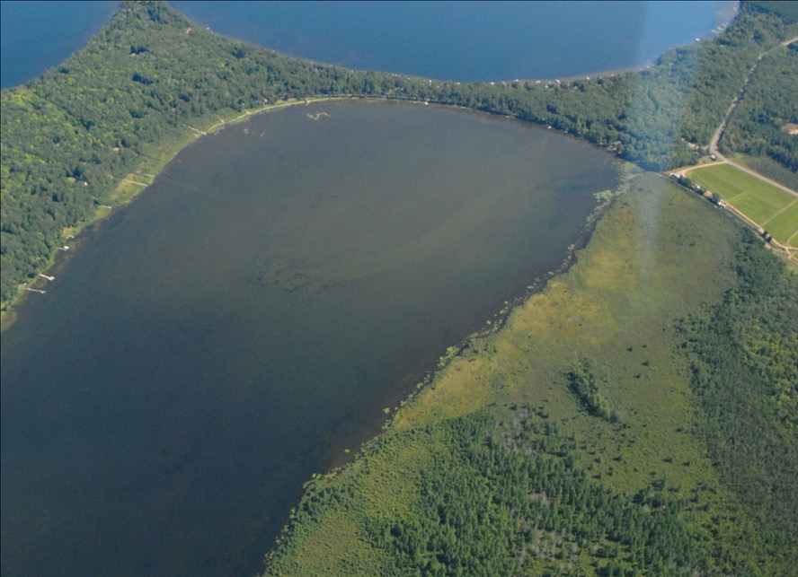
Musky Bay
August, 2008

Slide 13
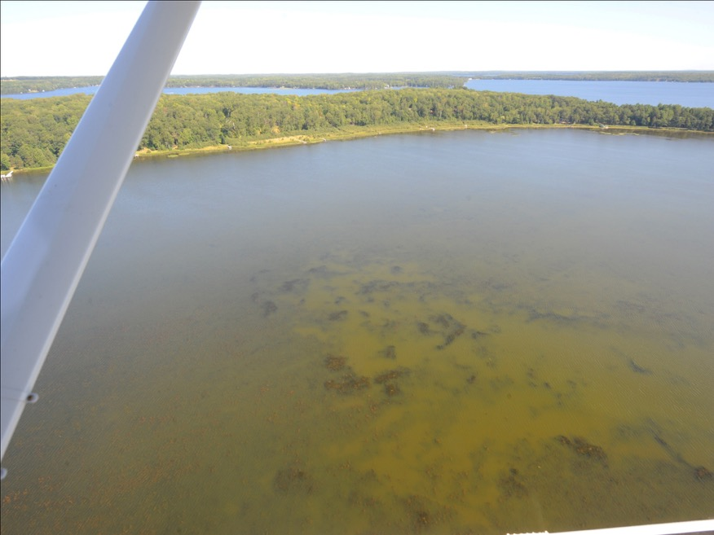

Slide 14
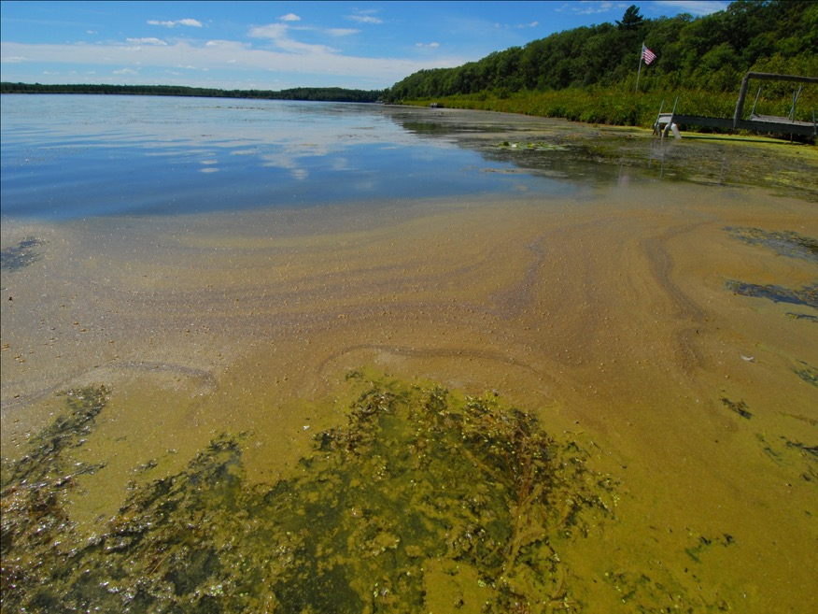

Slide 15
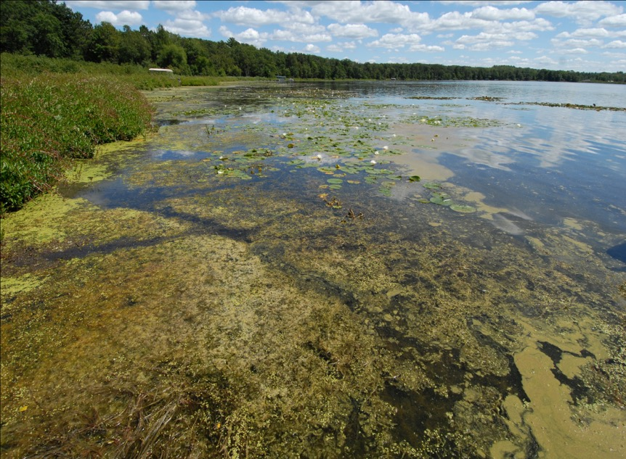

Slide 16
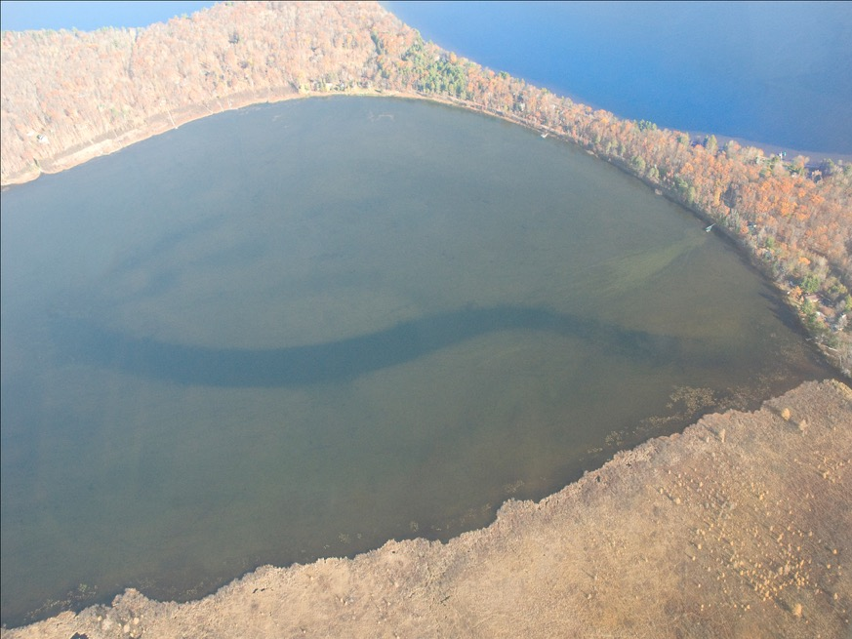

Slide 17
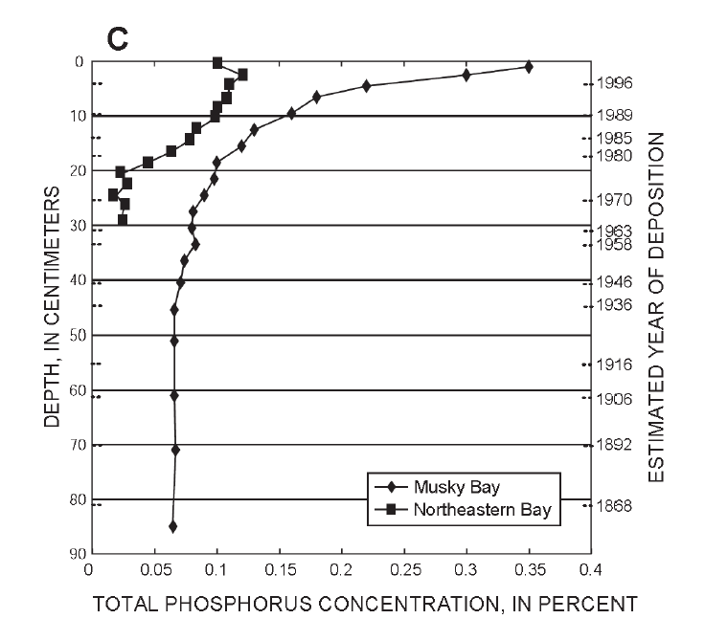
Historical water quality patterns in LCO were examined by USGS based on analyses of sediment cores collected in 1999 and 2001
Since the 1980’s, phosphorus levels increased dramatically
Best estimate of pre-development total phosphorus = 10ug/L
Notes:
Phosphorus concentrations in sediments of Musky Bay and Northeastern Bay, LCO with estimated date of deposition for the Musky Bay profile only.

Slide 18
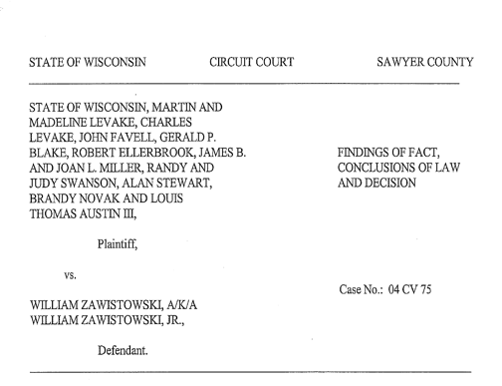
Musky Bay
Interplay between Wisconsin’s "Right to Farm Act” and an alleged nuisance on a public waterway
"There is perhaps no more impenetrable jungle in the entire law than that which surrounds the word 'nuisance'.” - Judge John P. Anderson

Slide 19
Musky Bay
“… Zawistowski can no longer hide behind a veil of self-imposed ignorance to the effects his cranberry operation is having on Musky Bay. His actions are beginning to interfere with a protected right, and the public is not without the ability to intervene, should the interference reach unreasonable levels. While Zawistowski may continue his operations as is, he does so at his own risk.”
- Judge John P. Anderson, April 5, 2006

Slide 20
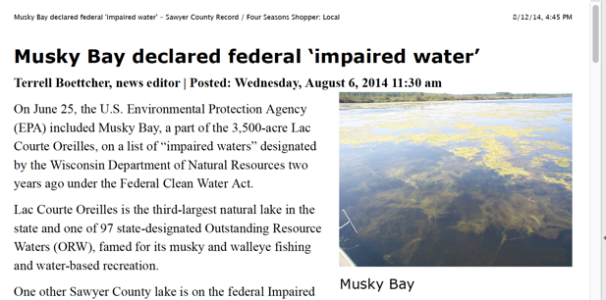
2007 - COLA requested impaired water status for Musky Bay from WDNR and EPA
2014 - Seven years and three listing cycles later, Musky Bay was finally designated as impaired for total P by WDNR and EPA
2016 - COLA requested impaired water status for entire lake
Notes:
1295 IW listings as of 2016, 209 added for 2016 (61% based on P)

Slide 21
WDNR considers Musky Bay to be separate and distinct from LCO and is a shallow (non-stratified) drainage lake
The applicable TP criterion for this class of lakes is 40 μg/L
Notes:
1295 IW listings as of 2016, 209 added for 2016 (61% based on P)

Slide 22
Hydrodynamic Model
[Click to animate]
Predicted dye concentrations in LCO at two-week intervals following release of 100 mg/L in Musky Bay on June 1
50% mix of water from Musky Bay to a large portion of the rest of the lake in as little as two months.
Based upon the Environmental Fluid Dynamics Code (EFDC), a U.S. EPA-supported modeling framework

Slide 23
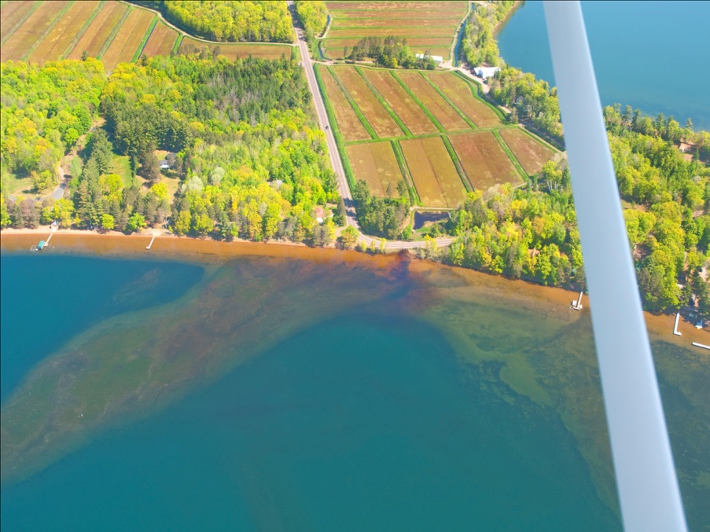
Stuckey Bay

Slide 24
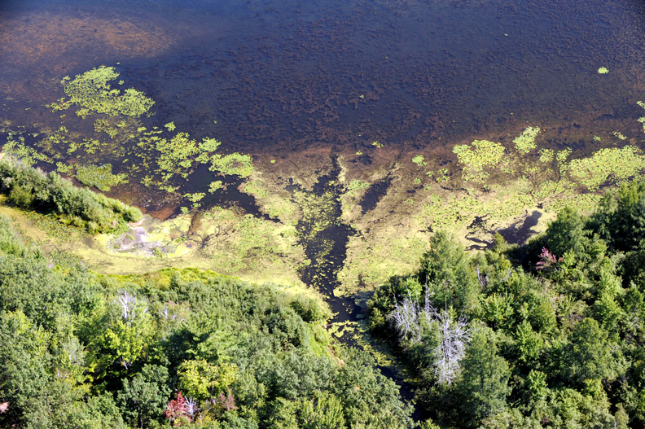

Slide 25
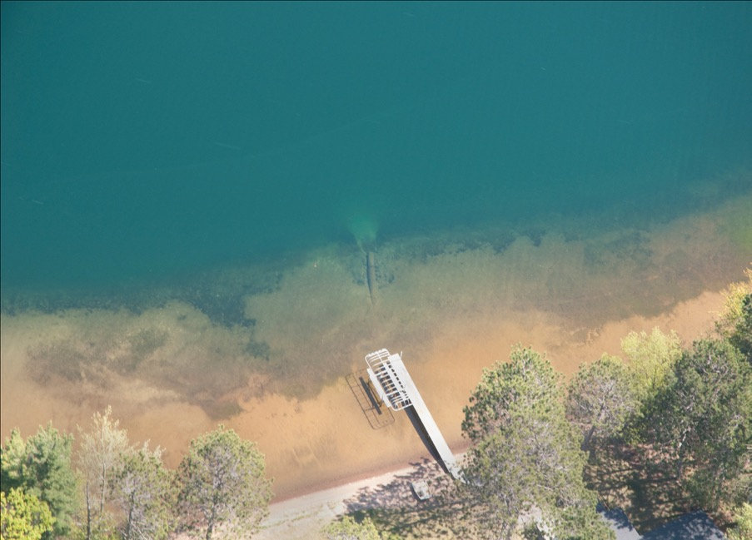
East shore

Slide 26
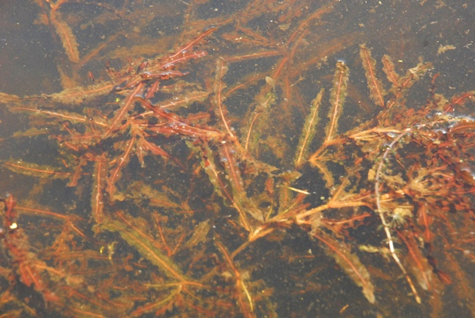
Curly leaf pondweed

Slide 27
Aquatic Invasive Species (AIS) in LCO
2009 CLP
2010 CLP

Slide 28
Curly Leaf Pondweed in LCO
AIS grant
Spot treatment with herbicide initiated in 2011
Curly leaf pondweed in Musky Bay has now been reduced from 90+ acres to less than 10 acres in 2016.
Notes:
Aquathol-K® (active ingredient endothall) and granular Clearcast 2.7g® (active ingredient imazamox) to 2014

Slide 29
Lac Courte Oreilles Foundation
The Lac Courte Oreilles Foundation Inc. (LCOFI) was founded in 2009 as a 501 (c) (3) non-profit
LCOFI is the money-generating arm: Money raised is put to work by COLA in the form of water quality improvement and study projects.
LCOFI raises and uses funds to stop pollution, restore habitat, research and study water quality issues, combat AIS, and educate people about proper lake stewardship
400+ donors have contributed >$700,000 since inception

Slide 30
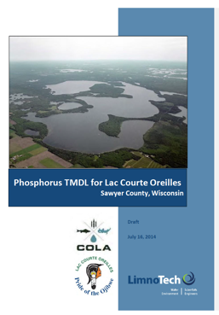
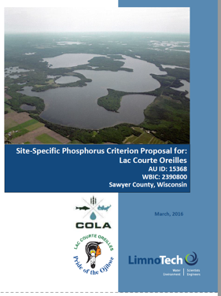
2011 - COLA and the LCO Tribe initiated a Total Maximum Daily Load study
13+ years for WDNR to act
COLA funded ~$200,000
COLA and the LCO Tribe followed up with a Site Specific Phosphorus Criterion proposal
Notes:
. LimnoTech is an independent water environment research and engineering firm based in Ann Arbor, MI, that regularly assists federal and state agencies, including the Wisconsin DNR, study lakes and streams across the country.

Slide 31
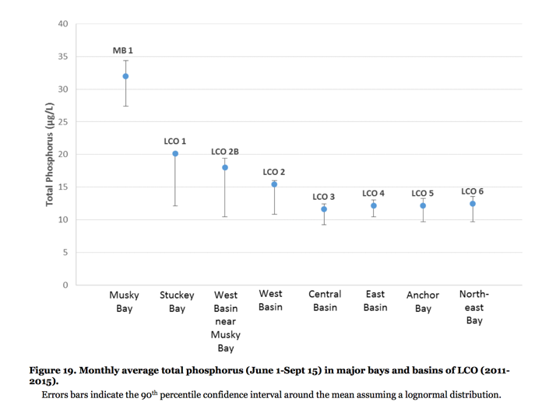

Slide 32
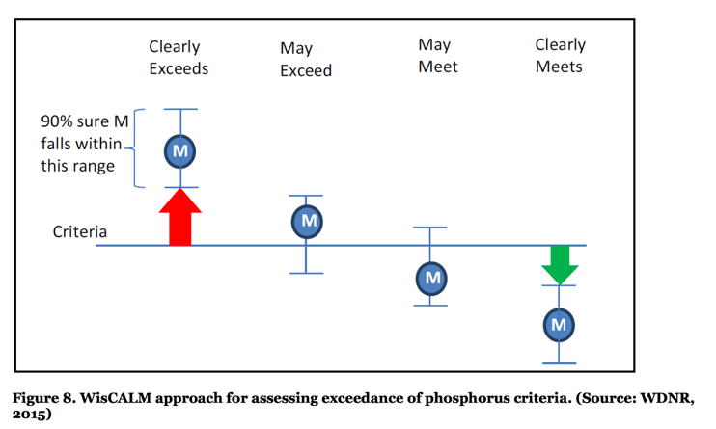
For LCO to be listed as impaired based solely on total phosphorus data, the average monthly total phosphorus must be greater than 22.5 μg/L – nearly 2x the current level of 13 μg/L!!
Notes:
“For a lake to be included on the 303(d) list as impaired and to have priority put on the development of a TMDL, using only total phosphorus data, the lower 90th percentile of the confidence interval around the mean must exceed the phosphorus criterion by more than 1.5 times (Figure 8). This basically means that for LCO to be listed as impaired based solely on total phosphorus data, there must be 95% certainty that the average monthly total phosphorus concentration is more than 150% of the current 15 μg/L criterion, or greater than 22.5 μg/L. Being 95% sure that total phosphorus is averaging greater than 22.5 μg/L in LCO is a high bar for determining impairment and taking needed steps to restore and protect the resource, especially considering LCO is an ORW.”

Slide 33
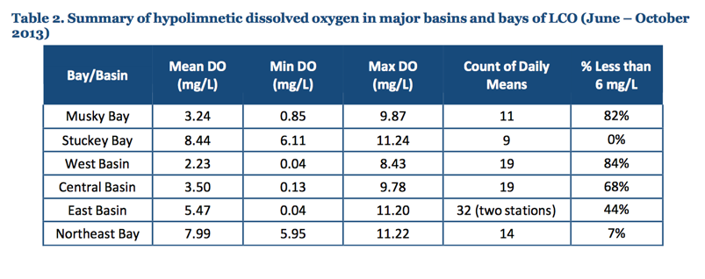
Significant extent and frequency of DO concentrations depressed below the 6 mg/L threshold for protection of a cold water fishery
Notes:
The Wisconsin Consolidated Assessment and Listing Methodology for 2014 (WisCALM; WDNR, 2013) specifies that for two-story lakes, the impairment threshold for dissolved oxygen is 5 mg/L in the epilimnion, and not less than 6 mg/L in the hypolimnion, where cold water species may be found. If 10% or more of all dissolved oxygen values are below the thresholds, the impairment threshold is exceeded.
The U.S. EPA has issued guidance for establishing dissolved oxygen criteria (USEPA, 1986). For salmonid, or cold water fish, beyond the early life embryo and larval stages, 3 mg/L is the limit to avoid acute mortality, and 5 mg/L is the criteria for moderate production impairment.

Slide 34
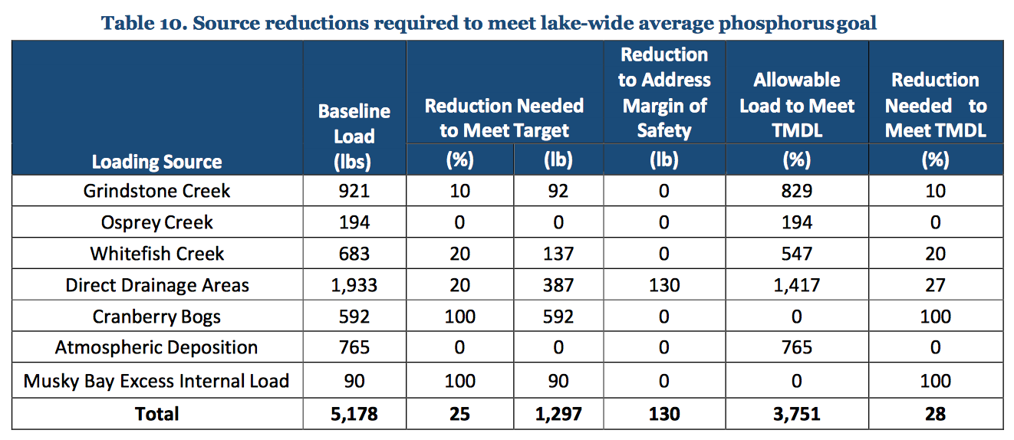
In order to comply with antidegradation of this ORW lake, the water quality goal has been set to a summer-wide average epilimnetic TP concentration of 10μg/L

Slide 35
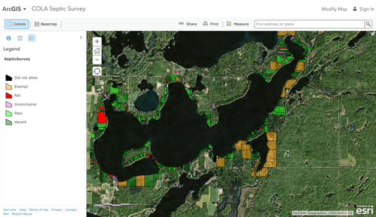
COLA spearheads a survey
of septic systems
A 2013 survey showed that 50 septic systems out of 600 on LCO were not operating properly
With the help of Sawyer County, LCO is now close to 100 percent compliance, with just a couple of systems needing to be replaced

Slide 36
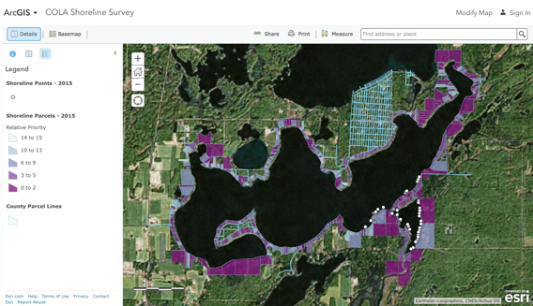
Wetland & Shoreline Habitat Restoration Grant
2015 – COLA received a $100,000 WDNR multi-year grant with 25% cost share for COLA
25 properties @ $4,000 each

Slide 37
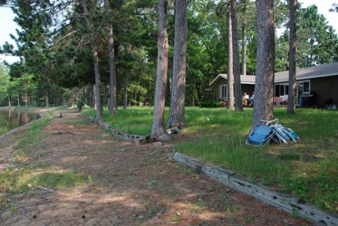
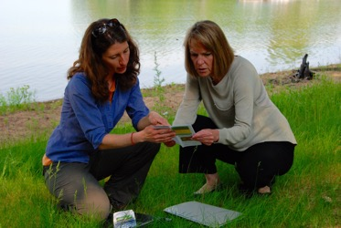
Wetland & Shoreline Habitat Restoration Grant
“COLA's long term goal is to establish shoreland buffer zones on 100 percent of the properties on the lakes and to be the catalyst for other watershed lakes to establish their buffer zones.”
Kris Sivertson, COLA President
Notes:
Act 55 prohibits counties from enacting shoreland zoning ordinances stronger than the state minimums.

Slide 38
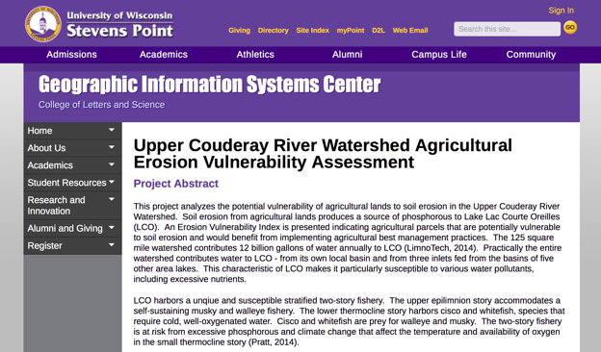
Agricultural Erosion Vulnerability Assessment
COLA and UW-SP have been working with Tim Seidl, Sawyer County Zoning and Conservation Department, and Ron Speiring, Natural Resources Conservation Service, Spooner. Doug Miskowiak is the UW-SP Project Director .

Slide 39
July, 2014 – COLA/LCO Tribe sent the TMDL and SSPC to the WDNR for review
December, 2014 - WDNR suggested revisions and indicated that it will take 1½ years or more to develop procedural rules for reviewing SSCs
March 2016 – COLA/LCO Tribe submitted revised SSPC to WDNR and requested emergency rulemaking
May 2016 - WDNR rejects COLA/LCO Tribe SSPC emergency rulemaking request and stated it will be two or more years before it can begin review SSC’s
June 2016 – COLA/LCO Tribe requested for judicial review of SSPC rejection

Slide 40
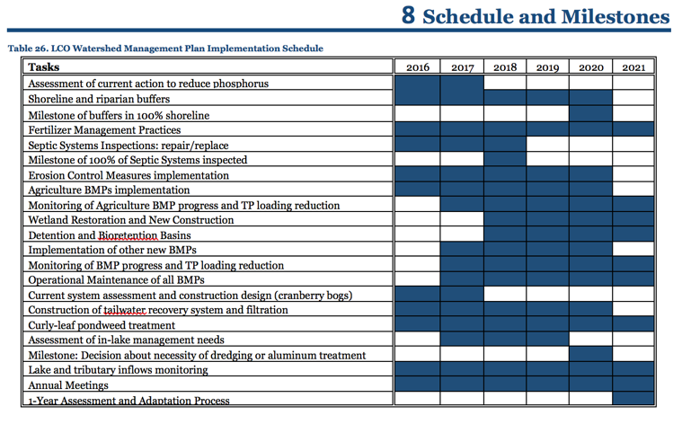
Nine Key Element Watershed Plan

Slide 41
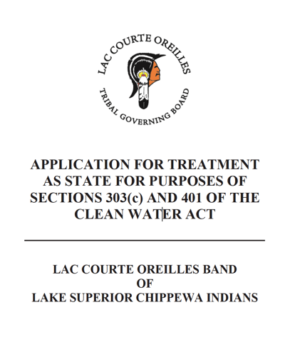
The Clean Water Act expressly provides for Indian tribes to play essentially the same role in Indian country that states do within state lands
Tribes shall be given “substantially” the same treatment as a state
LCO Tribe submitted application for TAS on July 25, 2016
If accepted, LCO Tribe will adopt the 10 ug/L standard for total P for its 1/3 portion of LCO
Notes:
The off-reservation portion of LCO is located within the 1837 Treaty Territory
that reserves and protects the Tribe’s fishing, gathering and hunting rights

Slide 42
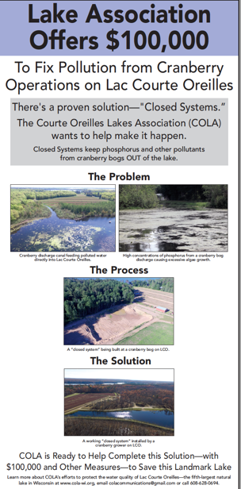
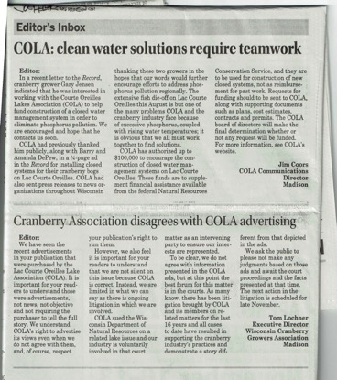
Supplement to financial assistance available from the Natural Resources Conservation Service
Construction of new closed systems, not as reimbursement for past work

Slide 43
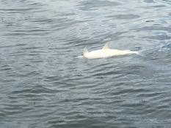
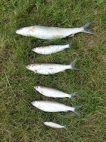
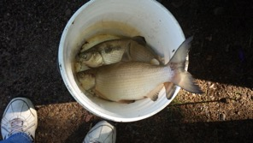
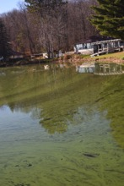
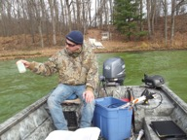
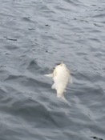
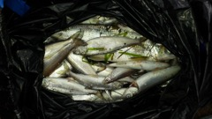
In the meantime ….
August 2016 - extensive cisco and whitefish die off
November 2016 – blue-green algal bloom

Slide 44
Probable cause of the fish kill was the elimination of suitable habitat for whitefish and cisco survival
Fish died from either thermal stress caused by high temperature or suffocation from lack of oxygen
Notes:
The band of water that included at least 3 mg/L dissolved oxygen and water temperatures less than 73° F was virtually eliminated throughout LCO at the time of the observed fish kill.
Maintaining minimum habitat conditions closer to a combination of 73° F and 6 mg/L dissolved oxygen is needed for cisco, and 66° F and 6 mg/L dissolved oxygen is needed to protect the resident whitefish in LCO.

Slide 45
BARR study - 1996
Anderson decision - 2006
Requested Impaired Water status based on total P from EPA – 2007
Lac Courte Oreilles Foundation formed - 2009
Lake Management Plan – February 2011
Initiated TMDL study – 2011 ($200,000)
Initial AIS grant – 2011
Septic Survey - 2013
Impaired Waters final designation by EPA and WDNR – June 2014
TMDL and SSPC submitted to WDNR – July 2014
WDNR responds with suggested revisions – December 2014
Shoreland restoration grant - 2015
Revised SSPC and TMDL submitted to WDNR– March 2016
requesting emergency rulemaking
Rejection of SSPC by WDNR – May 2016
WDNR suggests dropping TMDL and preparing 9-key element plan
Request for Judicial Review – June 2016
TAS submittal to EPA by LCO Tribe – July 2016
Draft 9-point plan prepared -
TAS in place -
Timeline

